Slide 1
Network Security
CS425

Slide 2
Basics of Cryptography
Link Layer Security
Network Layer Security
Transport Layer Security
Application Layer Security

Slide 3
Basics of Cryptography

Slide 4
Cryptology
Cryptography
&
Cryptanalysis
The point of cryptography is to send secure messages over an insecure medium (like the Internet!)
Cryptanalysis studies cryptographic systems to look for weaknesses or leaks of information

Slide 5




Cast of Characters
The good guys: Alice and Bob
Bad Guys: Eve, Mallory

Slide 6
Building Blocks
Three main components:
Confidentiality
Integrity
Authenticity
Preventing Eve from reading Alice’s messages
Preventing Eve from Modifying Alice’s messages without being detected
Preventing Eve from impersonating Alice

Slide 7
Strong Cryptosystems
What is an ideal property of a Strong Cryptosystem?
Never have SECRET Encryption Algorithm!

Slide 8
Kerckhoff’s principle
A cryptosystem should be secure, even if everything about the system, except the key, is public knowledge.

Slide 9
Strong Cryptosystems
We assume that the attacker (Eve) has the following information:
Knows the Algorithm
Knows some part of the plain text
Knows a number of corresponding plaintext/ciphertext pairs
Have access to an encryption/decryption oracle

Slide 10

What is Encryption?
secret
message

Slide 11

What is Encryption?

Slide 12
What is Encryption?

Slide 13
Encryption
An encryption scheme has three main algorithms
Gen creates the keys
Enc locks a message under a given key
Dec unlocks a message under a given key

Slide 14
Old Ciphers
A
B
C
D
E
F
G
H
A
B
C
D
E
F
G
H
These ciphers are quite bad, though!

Slide 15

Vernam Pad
1
1
0
1
0
0
0
1
0
1
0
0
1
0
1
1
1
0
0
1
1
0
1
0

Slide 16
Vernam’s One Time Pad
Provides Information Theoretic Security
No matter how computationally strong the adversary is, One Time Pad cannot be broken.

Slide 17
Vernam’s One-Time Pad
Gen(1^{n}) generates keys (referred to as pads)
Input: an integer ⇒ length of key
Output: a random n-bit string, k∈{0，1}ⁿ

Slide 18
If your boss stores your salary (in binary) encrypted using OTP what can you do with the cipher text?
You can XOR a “1000000 …. “. This flips the most significant

Slide 19

Problems with One-Time Pads
The key must be truly random.
Another problem is that key should be size of the message.
The key must not be used more than once.
Two Time Pads do not work.

Slide 20







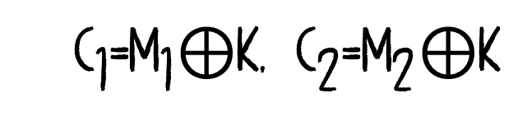
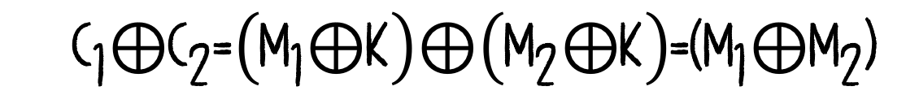


Problems with a two-time Pad
What happens if you use the same key to encrypt two messages?
Messages are not purely random.
$${\text{C}}_{\text{1}}\text{=}{\text{M}}_{\text{1}}\text{⊕}\text{K}\text{, }{\text{C}}_{\text{2}}\text{=}{\text{M}}_{\text{2}}\text{⊕}\text{K}$$
$$\text{=}$$
$$\text{⊕}$$
$${\text{C}}_{\text{1}}\text{⊕}{\text{C}}_{\text{2}}\text{=}\left({\text{M}}_{\text{1}}\text{⊕}\text{K}\right)\text{⊕}\left({\text{M}}_{\text{2}}\text{⊕}\text{K}\right)\text{=(}{\text{M}}_{\text{1}}\text{⊕}{\text{M}}_{\text{2}}\text{)}$$

Slide 21
Computation Security
In contrast to One-Time Pad’s perfect or Information Theoretic security, most cryptosystems have computational security.
This means that it is certain they can be broken by enough work by Eve
Enough == IMPRACTICAL

Slide 22

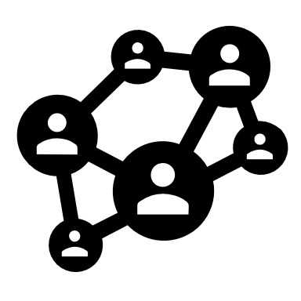

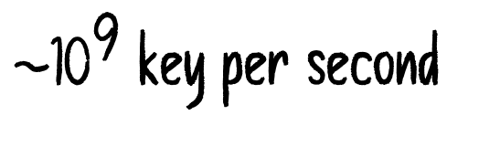
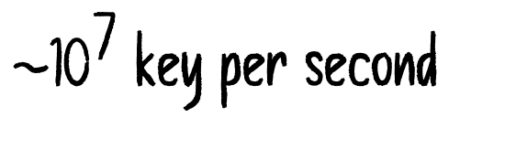

40-bit Security
This was the US legal export limit for a long time (cryptosystems were classified as munitions unit the late 90’s)
${\text{2}}^{\text{40}}$ $\text{\sim }$ ${\text{10}}^{\text{12}}$ possible keys
${\text{\sim }\text{10}}^{\text{7}}$ key per second
Computer
18 hours
${\text{\sim }\text{10}}^{\text{9}}$ key per second
Lab
11 hours
${\text{\sim }\text{10}}^{\text{20}}$ key per second
Bitcoin Network
4.2 ns

Slide 23



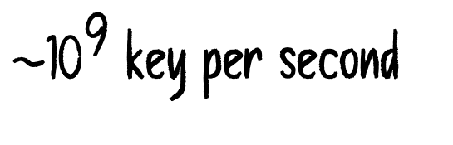
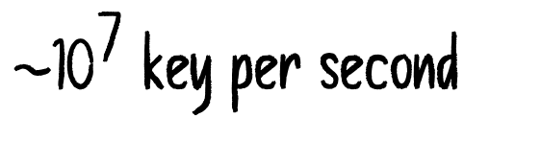
56-bit Security
This was the US Government Standard (DES) for a long time
${\text{2}}^{\text{56}}$ $\text{\sim }$ ${\text{7.2 }\text{x}\text{ 10}}^{\text{26}}$ possible keys
${\text{\sim }\text{10}}^{\text{7}}$ key per second
Computer
134 years
${\text{\sim }\text{10}}^{\text{9}}$ key per second
Lab
16 months
${\text{\sim }\text{10}}^{\text{20}}$ key per second
Bitcoin Network
0.22 ms

Slide 24

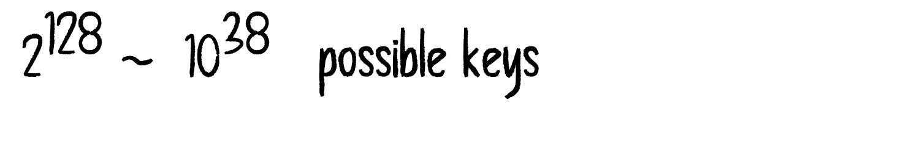
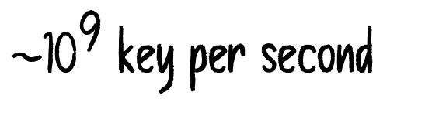
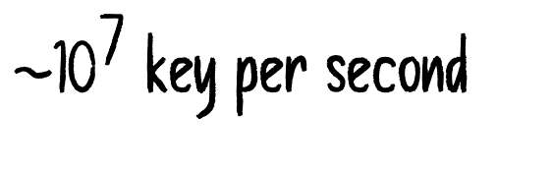
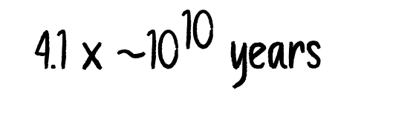
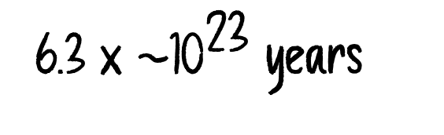
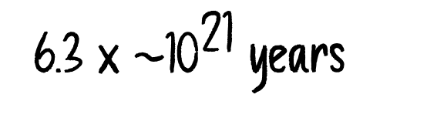
128-bit Security
This is the modern Standard
${\text{2}}^{\text{128}}$ $\text{\sim }$ ${\text{ 10}}^{\text{38}}$ possible keys
${\text{\sim }\text{10}}^{\text{7}}$ key per second
6.3 x ${\text{\sim }\text{10}}^{\text{23}}$ years
Computer
${\text{\sim }\text{10}}^{\text{9}}$ key per second
6.3 x ${\text{\sim }\text{10}}^{\text{21}}$ years
Lab
${\text{\sim }\text{10}}^{\text{20}}$ key per second
4.1 x ${\text{\sim }\text{10}}^{\text{10}}$ years
Bitcoin Network

Slide 25
What about Quantum Computers?
They will not really help
What about Moore’s Law?
If we believe Moore’s Law after 132 years we’ll have computers that break 128-bit Crypto in 132 years

Slide 26

Secret Key Cryptography
Encryption
Decryption

Slide 27
Types of secret-key cryptosystems
Block Cipher
operate one block at a time
Stream Cipher
operate one bit at a time

Slide 28

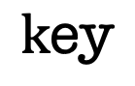
Stream Cipher
A stream cipher operates one bit at a time. Basically, take the One-Time Pad, but use a pseudorandom keystream instead of a truly random one.
plaintext
$$\text{k}\text{ey}$$
$$⊕$$
keystream
Pseudorandom Keystream Generator
ciphertext

Slide 29


Stream Ciphers
Can be very fast! And can allow us to send a lot of data securely
We saw the issue with re-using a key (two-time pad) WEP, PPTP are great examples of how NOT use stream ciphers.
Concatenate the key with nonce.

Slide 30
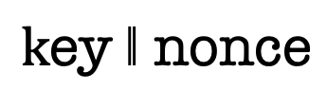
Stream Cipher
Stream ciphers can be very fast
But they are very tricky to use correctly!
plaintext
$$\text{k}\text{ey} \text{‖ }\text{nonce}$$
$$⊕$$
keystream
Pseudorandom Keystream Generator
ciphertext

Slide 31
Block Ciphers
Operate on the messages one block at a time. Blocks are usually 64 or 128 bits long.
Example: AES is a block cipher everyone should use today.
(unless you have a really good reason)

Slide 32


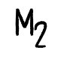
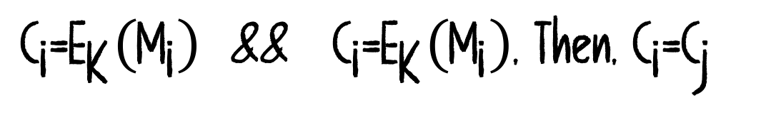
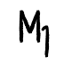
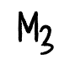
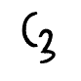
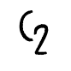
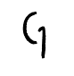
E
Encrypts each successive block separately.
$${\text{M}}_{\text{1}}$$
$${\text{C}}_{\text{1}}$$
What happens if some blocks in the plain text are identical.
E
$${\text{M}}_{\text{2}}$$
$${\text{C}}_{\text{2}}$$
${\text{C}}_{\text{i}}\text{=}{\text{E}}_{\text{K}}\left({\text{M}}_{\text{i}}\right)$ && ${\text{C}}_{\text{i}}\text{=}{\text{E}}_{\text{K}}\left({\text{M}}_{\text{i}}\right)$, Then, ${\text{C}}_{\text{i}}\text{=}{\text{C}}_{\text{j}}$
E
$${\text{M}}_{\text{3}}$$
$${\text{C}}_{\text{3}}$$

Slide 33



Slide 34


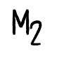
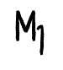
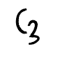
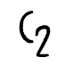
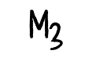
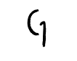
We can provide feedback among different block, to avoid repeating patterns
$${\text{M}}_{\text{1}}$$
E
$${\text{C}}_{\text{1}}$$
Does this avoid repeating patterns?
$${\text{M}}_{\text{2}}$$
E
$${\text{C}}_{\text{2}}$$
We can undo the XOR if we get all the cipher texts
$${\text{M}}_{\text{3}}$$
E
$${\text{C}}_{\text{3}}$$

Slide 35
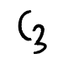
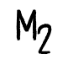
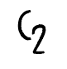
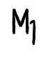

IV
Does this solve the issue of encrypting equal block?
$${\text{M}}_{\text{1}}$$
E
$${\text{C}}_{\text{1}}$$
Yes, This is called CBC mode
$${\text{M}}_{\text{2}}$$
E
$${\text{C}}_{\text{2}}$$
Can we share IV in the clear?
$${\text{M}}_{\text{3}}$$
Yes!!!
E
$${\text{C}}_{\text{3}}$$

Slide 36


Slide 37
Public Key Cryptography

Slide 38

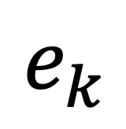
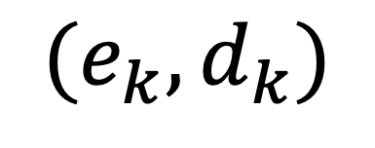
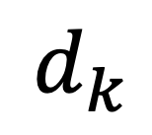
Public Key Cryptography
Bob creates
a key pair
$$(e_{k}, d_{k})$$
$$e_{k}$$
Bob gives everyone a copy of his public encryption key:
Alice uses it to encrypt a message and sends the encrypted message to Bob
$$d_{k}$$
Bob uses his private decryption key
to decrypt the message

Slide 39

Public Key Cryptography
Bob’s Public Key
Bob’s Private Key
Encrypt
Decrypt

Slide 40
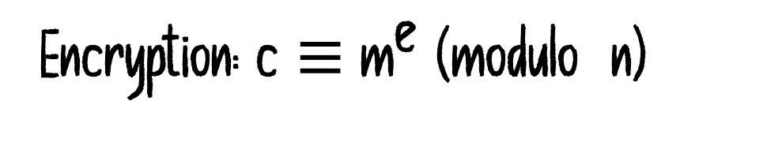


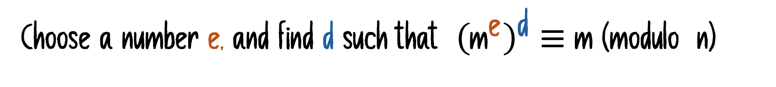
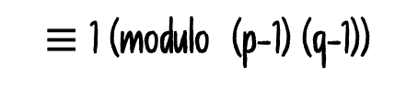


Textbook RSA
e
d
$$\text{≡}\text{ 1 (}\text{modulo}\text{ (}\text{p}\text{−1) (}\text{q}\text{−1))}$$
Choose two large primes p and q.
Co-prime to (p-1)(q-1)
Compute $\text{n}\text{ = }\text{p}\text{⋅}\text{q}$
Choose a number e, and find d such that ${\left({\text{m}}^{\text{e}}\right)}^{\text{d}} \text{≡} \text{m}\text{ (}\text{modulo} \text{n}\text{)}$
Public Key: $\text{(}\text{e}\text{, }\text{n}\text{)}$
Private Key: $\text{d}$
Encryption: $\text{c}\text{ ≡}{ \text{m}}^{\text{e}}\text{ (}\text{modulo} \text{n}\text{)}$
Decryption: ${\left(\text{c}\right)}^{\text{d}} \text{m}\text{ (}\text{modulo} \text{n}\text{)}$

Slide 41
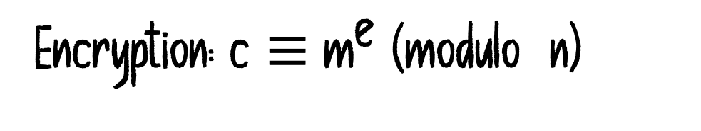
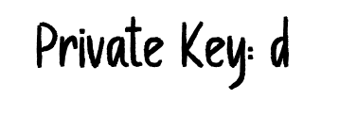
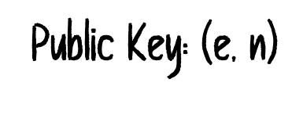
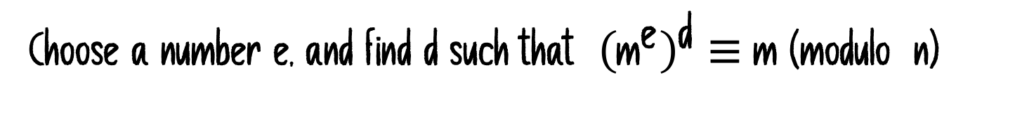


Choose two large primes p and q.
Compute $\text{n}\text{ = }\text{p}\text{⋅}\text{q}$
Choose a number e, and find d such that ${\left({\text{m}}^{\text{e}}\right)}^{\text{d}} \text{≡} \text{m}\text{ (}\text{modulo} \text{n}\text{)}$
Public Key: $\text{(}\text{e}\text{, }\text{n}\text{)}$
Private Key: $\text{d}$
Encryption: $\text{c}\text{ ≡}{ \text{m}}^{\text{e}}\text{ (}\text{modulo} \text{n}\text{)}$
Decryption: ${\left(\text{c}\right)}^{\text{d}} \text{m}\text{ (}\text{modulo} \text{n}\text{)}$
We are Eve. Alice is using RSA and her public key is $\text{(}\text{e}\text{, }\text{n}\text{)}$
Bob sends a super secret message m which is encrypted as c = E(m). We intercept c
Can we ask Alice to decrypt something else that helps us generate m?

Slide 42

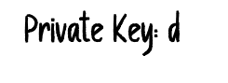

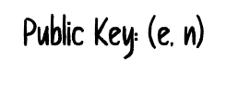





Can we ask Alice to decrypt something else that helps us generate m?
Choose two large primes p and q.
Compute $\text{n}\text{ = }\text{p}\text{⋅}\text{q}$
Choose a number e, and find d such that ${\left({\text{m}}^{\text{e}}\right)}^{\text{d}} \text{≡} \text{m}\text{ (}\text{modulo} \text{n}\text{)}$
Public Key: $\text{(}\text{e}\text{, }\text{n}\text{)}$
Private Key: $\text{d}$
Encryption: $\text{c}\text{ ≡}{ \text{m}}^{\text{e}}\text{ (}\text{modulo} \text{n}\text{)}$
Decryption: ${\left(\text{c}\right)}^{\text{d}} \text{m}\text{ (}\text{modulo} \text{n}\text{)}$
Bob sends ${\text{c}}_{\text{1}}$ = ${\text{E}}_{\text{e}}$(m). We intercept ${\text{c}}_{\text{1}}$.
We ask Alice to decrypt ${\text{c}}_{\text{2}}≡{\text{2}}^{\text{e}}\text{⋅}{\text{c}}_{\text{1}}$
The decrypt, yields: ${\left({\text{2}}^{\text{e}}\text{⋅}{\text{c}}_{\text{1}}\right)}^{\text{d}}\text{= 2}\text{m}$
We divide the result by 2, and we get m.

Slide 43

Integrity
How do we tell if a message has changed in transit?
The most straightforward answer is to use a checksum!
But checksums do not really work (we have seen that!)
What can Eve do?
(encrypted)

Slide 44
Cryptographic Checksum
Cryptographic Hash Function

Slide 45
A function
that turns
any message
into a
short
unique
irreversible
string of bits
The output of the hash function is called the hash or a digest

Slide 46
A function
predictable mapping of inputs↦outputs
- Mapping is deterministic: H(x)==H(x), always

Slide 47
any message
input can be any bit string of any length
- whether 1 byte or 100 petabyte or more

Slide 48
short
output is a string of some fixed length
- most commonly that’s 256 bits (32 bytes), though 128, 192, 512… aren’t unheard of

Slide 49
unique
two inputs “almost always” map to two outputs*
- there are 2²⁵⁶ possible outputs
(2²⁵⁶ is a really, really, REALLY big number…)

Slide 50
Authentication
How can Alice be sure that she is talking to Bob?
We can use key has functions that are usually called Message Authentication Code
Only those who know the secret key can generate, on even check, the computed hash value (sometimes called a tag).

Slide 51
Authentication
M
H(M)
What is wrong with this?
How can we fix it?
M
H( )

Slide 52
Message Authentication Codes
m
MAC
=?
MAC

Slide 53
Message Authentication Codes
Is MAC a good way to authenticate financial transactions?
NO!

Slide 54
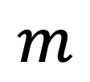
Digital Signatures
$$m$$
Verify
T/F
Sign
Sig
Alice Signing Key
(Private to Alice)
Alice Verification Key

Slide 55
Key Exchange

Slide 56
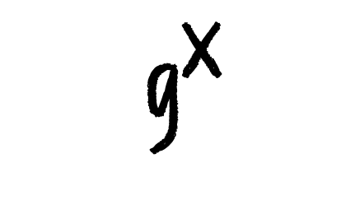
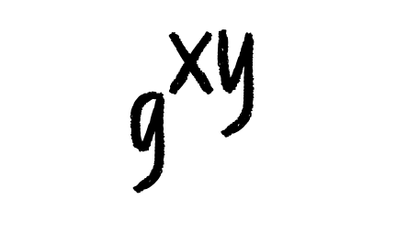

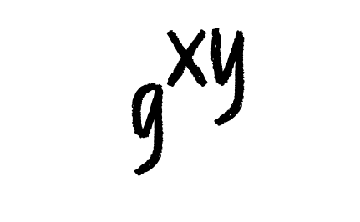
Key Exchange
x is Private to Alice
y is Private to Bob
$${ \text{g}}^{\text{x}}$$
$${ \text{g}}^{\text{y}}$$
$${ \text{g}}^{\text{xy}}$$
$${ \text{g}}^{\text{xy}}$$

Slide 57
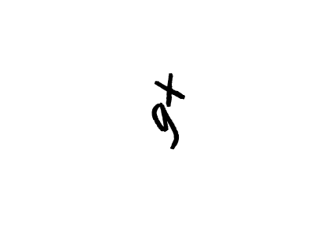
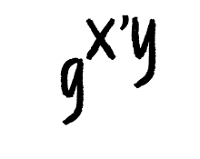






Key Exchange
$${ \text{g}}^{\text{xy}’}$$
$${ \text{g}}^{\text{x}’\text{y}}$$
$${ \text{g}}^{\text{y}}$$
$${ \text{g}}^{\text{x}}$$
$${ \text{g}}^{\text{y}’}$$
$${ \text{g}}^{\text{x}’}$$
$${ \text{g}}^{\text{xy}’}$$
$${ \text{g}}^{\text{x}’\text{y}}$$

Slide 58




Key Exchange
$${ \text{g}}^{\text{y}}$$
$${ σ(\text{g}}^{\text{x}})$$
$${ σ(\text{g}}^{\text{y}})$$
$${ \text{g}}^{\text{x}}$$
Verifies the signature using Bob’s Public Key
Verifies the signature using Alices’s Public Key

Slide 59

Key Management
But how does Alice get Bob’s public key?
$$pk_{b}$$

Slide 60


Key Management
But how does Alice get Bob’s public key?
$$pk_{e}$$
$$pk_{b}$$

Slide 61





Key Management
But how does Alice get Bob’s public key?
$$pk_{e}$$
$$pk_{b}$$
$$pk_{b}$$
$$σ_{T}(pk_{b})$$

Slide 62
Key Management
How can Alice and Bob ensure they are talking to each other?
By having each other’s verification key
Finding this verification key is a tough problem!

Slide 63
Certification Authority
A CA is a trusted third party that keeps a directory of people’s (and organizations) verification keys
Alice generates a
key pair, and sends the verification key and personal information, both signed with Alice’s signature key, to the CA
Secret Key
Verification Key
The CA ensures that the personal information and Alice’s signature are correct
The CA generates a certificate consisting of Alice’s personal information and her verification key.
The entire certificate is signed with the CA’s signature key

Slide 64
Bob’s Public Key
Bob’s Public Key
Certification Authority Identification
Bob’s Private Key
User Identification
User Identification

Slide 65



Slide 66
Certificate Authorities
Everyone is assumed to have a copy of the CA’s verification key so they can verify the signature on the certificate
There can be multiple levels of certificate authorities; level n CA issues certificates for level n+1 CAs – Public-key infrastructure (PKI)
Need to have only verification key of root CA to verify the certificate chain

Slide 67

WEP
Link Layer
Developed in 1999
Goal: Provide the same security in wired networks as it exists in wireless networks

Slide 68
WEP
WEP was intended to enforce three security goals:
Data Confidentiality
Data Integrity
Access Control
Prevent an adversary from modifying the wireless traffic or fabricating traffic that looks legitimate
Prevent an adversary from using your wireless infrastructure
Prevent an adversary from learning the contents of the wireless traffic

Slide 69
WEP
WEP achieved NONE of these goals!

Slide 70


WEP
Checksum!
c(M)
M
M
v
$$\text{⊕}$$
RC4
$$\text{=}$$
k
C

Slide 71
WEP: Transmitting a message
Compute a checksum c(M) (which does not depend on k)
Pick an IV v and generate a keystream K = RC4(v,k)
Ciphertext C = K ⊕ ⟨M ∥ c(M)⟩ Transmit v and C over the wireless link
Transmit v and C over the wireless link
What kind of cipher is this? What does the receiver do with v and C?

Slide 72
WEP: Receiving a message
Use the received v and the shared k for K = RC4(v, k)
Decrypt as K ⊕ C = K ⊕ K ⊕ ⟨M′ ∥ c′⟩ = M′ ∥ c′
Check to see if c′ = c(M′)
If it is, accept M′ as the message transmitted.

Slide 73
The problems with WEP
Key Reuse
Integrity Breach
WEP Authentication

Slide 74

Problem 1: Key Reuse
3 bytes
v
RC4
Keystream is derived as: K = RC4(v,k)
k
IV (v) is too short: only 3 bytes = 24 bits.
Secret (k) is rarely changed!
What is the problem with this?
Key-stream gets re-used after
$${\text{2}}^{\text{24}}$$
iterations
two-time pad.
How could we have avoided this?

Slide 75
Problem 2: Integrity Breach
The checksum algorithm in WEP is CRC32,
CRC32 has two important (and undesirable) properties:
It is independent of k and v
It is linear: c(M ⊕ δ) = c(M) ⊕ c(δ)

Slide 76


Problem 2: Integrity Breach
The sender transmits C and v. If Mallory wants to modify the plaintext
M into
$$\text{M}\text{′ = }\text{M}\text{ ⊕ }\text{δ}$$
Calculate:
$${\text{C}}^{\text{′}} \text{= }\text{C}\text{ ⊕ ⟨}\text{δ}\text{ ‖ }\text{c}\text{(}\text{δ}\text{) ⟩}$$
Send:
(C′,v) instead of (C,v)
This passes the integrity check of the recipient!

Slide 77








Problem 2: Integrity Breach
$$δ$$
$$c(δ)$$
v
$$⊕$$
C
=
C
CC
CC
c(M ⊕ δ) = c(M) ⊕ c(δ)
$$⊕$$
K
=
M
$$\text{c}\text{(}\text{M}\text{)}$$
$$⊕$$
$$δ$$
$$\text{c}\text{(}\text{δ}\text{)}$$

Slide 78

Problem 3: Authentication Disaster
Challenge
R
Response
C, v
$$\text{C}\text{ = }\text{RC}\text{4}\left(\text{k}\text{,}\text{v}\right) \text{⊕ ⟨}\text{R}\text{‖}\text{c}\left(\text{R}\right)\text{⟩}$$

Slide 79



Problem 3: Authentication Disaster
Mallory has seen R, C, v
R’
Challenge
$${\text{C}}^{\text{′}}\text{=}\text{RC}\text{4}\left(\text{k}\text{,}\text{v}\right)\text{⊕⟨}{\text{R}}^{\text{′}}\text{‖}\text{c}\left({\text{R}}^{\text{′}}\right)\text{⟩}$$
$$\text{C}\text{ = }\text{RC}\text{4}\left(\text{k}\text{,}\text{v}\right) \text{⊕ ⟨}\text{R}\text{‖}\text{c}\left(\text{R}\right)\text{⟩}$$
$${\text{C}}^{\text{′}}\text{= }\text{C}\text{ ⊕ ⟨}{\text{R}}^{\text{′}}\text{‖}\text{c}\left({\text{R}}^{\text{′}}\right)\text{⟩}$$

Slide 80
Problem 3: Authentication Disaster
The access point sends a challenge string R to the client.
The client sends back the challenge, WEP-encrypted with the shared secret k
The wireless access point checks if the challenge is correctly encrypted and, if so, accepts the client
The adversary has been both
R and (C, V)

Slide 81


Problem 3: Authentication Disaster
Mallory has seen R, c, v
Mallory wants to authenticate herself to the AP. The AP sends her a new challenge, R′. Can Mallory successfully run the authentication protocol?
Yes! Note that Mallory knows:
$$\text{RC}\text{4}\left(\text{k}\text{,}\text{v}\right)\text{=}\text{C}\text{⊕⟨}\text{R}\text{‖}\text{c}\left(\text{R}\right)\text{⟩}$$
Mallory can just compute:
$${\text{C}}^{\text{′}}\text{=}\text{RC}\text{4}\left(\text{k}\text{,}\text{v}\right)\text{⊕⟨}{\text{R}}^{\text{′}}\text{‖}\text{c}\left({\text{R}}^{\text{′}}\right)\text{⟩}$$
and send C’ to the Access Point

Slide 82

Problem 3: Mallory can run the authentication herself (previous slide)
But, more generally, she can inject packets.
We saw that seeing R, C, and v gives Mallory a value of v and the corresponding keystream RC4(v,k)
The same way Mallory encrypted the challenge R′ in the previous slide, she can encrypt any other value F:
$${\text{C}}^{\text{′}}\text{=⟨}\text{F}\left\|\text{c}\left(\text{F}\right)\right\rangle \text{⊕}\text{RC}\text{4(}\text{v}\text{,}\text{k}\text{)}$$
and she transmits
v ,C′
C′ is, in fact, a correct encryption of F, so the message must be accepted

Slide 83
Replacing WEP
Wi-fi Protected Access (WPA) was rolled out as a short-term patch to WEP while formal standards for a replacement protocol (IEEE 802.11i, later called WPA2) were being developed.
Replaces CRC-32 with a real MAC IV is 48 bits
The key is changed frequently (TKIP)
Ability to run on most older WEP hardware

Slide 84
Replacing WEP
The 802.11i standard was finalized in 2004, and the result (called WPA2) has been required for products calling themselves “Wi-fi” since 2006
Replaces the RC4 and MAC algorithms in WPA with the CCM authenticated encryption mode (using AES)

Slide 85
WEP Recap
Q: What have we learned from WEP? Respect to randomness? (provided by IVs?)
Respect to checksums?
Use sufficiently long IVs, don’t share a key with many people, don’t reuse
short-term secret keys and IVs. Do not use checksums for integrity. Use keyed MACs instead!

Slide 86
Feedback
Multiple Websites
Assignments
Hands-on Experience

Slide 87
Network Layer Security
1b
2b
3b
1a
1c
2a
2c
3a
3c
1d
2d
3d

Slide 88
IPSec
Extends the Internet Protocol (IP) to provide confidentiality and integrity of packets transmitted across networks
Sets up secure tunnels across insecure networks
Provides Authentication
And encryption

Slide 89
IPSec
Suppose every link in our network had strong link-layer security. Why would this not be enough?
Source and destination IPs may not share the same link.
Network layer threats such as IP spoofing still exist.
We need end-to-end security across networks, i.e., securing network layer packets from one host to another so that routers or other hosts in the middle cannot modify or read the packet payload (they still need to read packet metadata for routing)

Slide 90
IPSec
The IP Security suite (IPSec) extends the Internet Protocol (IP) to provide confidentiality and integrity of packets transmitted across the network.
IPSec enables various architectures of Virtual Private Networks (VPNs), which is the foundation of network-layer security.

Slide 91
IPSec
Why does the checksum provided in the IP protocol not provide Network Security?

Slide 92



Network Layer Security
Internet Untrusted Network
Host-to-Host
(not VPN)
IPSec Gateway
IPSec Gateway
Internet Untrusted Network
Gateway to Gateway, VPN Model
Internet Untrusted Network
IPSec Gateway
Remote Access
VPN Model

Slide 93
Modes of Operation
Transport Mode
Tunnel Mode
Use case: End-to-end communication between two hosts (e.g., two servers, two laptops).
Use case: Gateway-to-gateway (e.g., VPN), host-to-gateway, or host-to-host via VPN.
Encryption scope: The entire original IP packet (including the original IP header) is encrypted.
Encryption scope: Only the payload (data + transport layer headers) of the IP packet is encrypted.
Original IP header: Remains intact and visible to intermediate routers
New IP header: A new outer IP header is added to route the packet between IPSec endpoints.
[IP Header][Encrypted Payload (TCP/UDP + Data)]
[New IP Header][Encrypted Original IP Header + Payload]

Slide 94
Recall the IP-Diagram
IP Header
TCP/UDP Header
TCP/UDP Payload

Slide 95
Recall the IP-Diagram
Original IP Header
IPSec Header Added
IP Header
IPSec Header
TCP/UDP Header
TCP/UDP Payload
Transport Mode

Slide 96
Recall the IP-Diagram
IP Header
TCP/UDP Header
TCP/UDP Payload

Slide 97
Recall the IP-Diagram
(A to G)
(A to B)
Outer IP Header
Inner IP Header
IP Header
IPSec Header
IP Header
TCP/UDP Header
TCP/UDP Payload
Original IP Header
Tunnel Mode
Internet Untrusted Network
B
G
A

Slide 98
Network Layer Security
AH
(Authentication Header)
Protocols
IPSec
ESP
(Encapsulating Security Payload)
IKE
Key Management

Slide 99
IPSec Overview
Internet Key Exchange
To agree on a shared symmetric key.
We use this key to encrypt and compute MACs over IP packets or parts of it.

Slide 100
Key Exchange
x is Private to Alice
y is Private to Bob
$${ \text{g}}^{\text{x}}$$
$${ \text{g}}^{\text{y}}$$
$${ \text{g}}^{\text{xy}}$$
$${ \text{g}}^{\text{xy}}$$

Slide 101
IPSEC VPN Fundamentals (IKE Phase 1)
Authentication using certificates
DH Key Exchange

Slide 102
IPSEC VPN Fundamentals (IKE Phase 1)
Symmetric Key is used to encrypt and decrypt agreements and key materials
e.g. ciphers suites supported
The DH Key and the key material above is used to create a new key IPSec Key
IPSec Key is used to encrypt the traffic across the tunnel

Slide 103
IPSec Headers
Authentication Header (AH) – RFC4302
Offers integrity and data source authentication
Offers protection against replay attacks (via extended sequence numbers)
Provides no confidentiality

Slide 104
IPSec: Authentication Header (AH) View
IP Header
IP Header
Next Header
Payload Length
Reserved
SPI (Security Parameter Index)
Auth Header
Sequence Number
MAC for authentication (integrity check)
Transport Mode: TCP Header + Data
IPSec payload
Payload
Tunnel Mode: IP Header + TCP Header + Data

Slide 105
IPSec: Authentication Header (AH) View
MAC for authentication (integrity check)
Integrity Check is calculated over the entire packet
Includes Auth Header
Excludes fields that change during routing (e.g. TTL) and Authentication data
The integrity check is MAC
Does not work with NAT. Why?

Slide 106
IPSec Headers
Encapsulated Security Payload (ESP) – RFC4303
Offers confidentiality
IP data is encrypted during transmission
Offers authentication functionality similar to AH
But authenticity checks only focus on the IP payload
Applies padding and generates dummy traffic, Makes traffic analysis harder

Slide 107
IPSec: Encapsulated Security Payload (ESP) View
IP Header
SPI (security parameters index)
Sequence Number
IPsec payload
(typically ENCRYPTED)
Padding (related to cipher block length)
Padding Len
Next Header
MAC for authentication (integrity check)

Slide 108
IPSec: ESP
ESP authenticates the ESP header and payload but not the IP header
Allows NAT
but TCP port numbers are no longer visible to NAT devices.
Why?
Why?

Slide 109
IPSec: ESP
Can the IP addresses be spoofed?
No, Authentication Phase

Slide 110
AH vs. ESP
AH protects the IP header
ESP can also protect it in tunnel mode
AH protects the IP header.
ESP does not expose the layer 4 information that firewalls require.

Slide 111

IPSec packets’ format

Slide 112
VPN Example
[IP Header]
- Source IP: 192.0.2.10 (Your device)
- Destination IP: 93.184.216.34 (example.com)
[TCP Header]
- Source Port: 54321
- Destination Port: 80
[Payload]
- HTTP GET / HTTP/1.1
Without VPN

Slide 113
VPN Example
Your original packet is encrypted and wrapped inside another packet.
[Outer IP Header]
- Source IP: 192.0.2.10 (Your device)
- Destination IP: 203.0.113.5 (VPN server)
[VPN Protocol Header]
- Protocol: OpenVPN / WireGuard / IPSec, etc.
[Inner IP Header]
- Source IP: 10.8.0.2 (VPN-assigned private IP)
- Destination IP: 93.184.216.34 (example.com)
[Inner TCP Header + Payload]
- Same as before
Intermediaries (e.g., ISP) only see you're talking to the VPN server, but not the final destination (example.com) or the contents.

Slide 114
VPN Example
[IP Header]
- Source IP: 203.0.113.5 (VPN server)
- Destination IP: 93.184.216.34
[TCP Header + Payload]
- Same as original
The VPN server decrypts and removes the outer header.
It forwards the inner packet to example.com but now modifies the source IP to its own:

Slide 115
VPN Example
example.com replies to the VPN server.
[Outer IP Header]
- Source IP: 203.0.113.5 (VPN server)
- Destination IP: 192.0.2.10 (Your device)
[Encrypted Payload]
- Contains the response from `example.com`
The VPN server wraps the response and sends it back through the encrypted tunnel.

Slide 116
IPSec deployment challenges
Needs to be included in the kernel’s network stack.
There may be legitimate reasons to modify some IP header fields; IPSec breaks networking functionalities that require such changes.
with AH, you cannot replace a private address for a public one at a NAT box.
with ESP, it depends
In transport usually does not work due to TCP and UDP checksums
In tunnel mode, it is fine
IPSec is complex, hard to audit, and prone to misconfigurations

Slide 117
TLS
HTTP
TCP
IP
Ethernet

Slide 118
TLS
HTTP
Can we just encrypt HTTP?
TCP
IP
Ethernet

Slide 119
TLS
HTTP
TLS
TCP
IP
Ethernet

Slide 120
TLS/SSL
In the mid-1990s, Netscape invented a protocol called Secure Sockets Layer (SSL) meant for protecting HTTP (web) connections.
The protocol, however, was general and could be used to protect any TCP-based connection.
HTTP + SSL = HTTPS
Historical note: there was a competing protocol called S-HTTP. But Netscape and Microsoft both chose HTTPS, so that’s the protocol everyone else followed
SSL went through a few revisions and was eventually standardized into the protocol known as TLS (Transport Layer Security, imaginatively enough)

Slide 121
TLS
The client connects to the server and indicates it wants to speak TLS, with
The Client key-share under ECDHE.
Elliptical Curve Diffie-Helmann Exchange
The list of ciphersuites it knows
Server sends its certificate to client, which contains:
Server key-share under ECDHE
Its hostname
Its verification key
Some other administrative information
A signature from a Certificate Authority (CA)

Slide 122
TLS
Both client and server derives the same session key K (which is hard for Eve to derive) based on the two key shares
Server also chooses which ciphersuite to use
All remaining traffic will be encrypted and authenticated under K

Slide 123

Connection Establishment

Slide 124
TLS Guarantees
Server authentication
Message integrity
Message confidentiality
Client authentication (optional)

Slide 125

Certification Authorities (CA) in TLS
A certification authority acts as a trusted third-party that:
Issues digital certificates
Certifies the ownership of a public key by the named subject of the certificate
Manages certificate revocation lists (CRLs)
Picture drawn by Simon Oya

Slide 126


Slide 127



What can go wrong with TLS
Basic idea: Alice accepts the connection if she receives a certificate and the certificate is signed by a CA she trusts
$${\text{v}}_{\text{K}}^{\text{CA}}$$
The certificate is for the domain she’s requesting
Picture drawn by Simon Oya
$${\text{v}}_{\text{K}}^{\text{WS}}$$
When talking to the web server, Alice can verify the signatures with

Slide 128

What can go wrong with TLS
An adversary can compromise a CA to plant fake certificates (e.g., DigiNotar’s fake *.google.com certificates used by an ISP in Iran)
Picture drawn by Simon Oya

Slide 129

What can go wrong with TLS
An adversary can install a custom CA on users’ devices, allowing them to sign certificates that clients will accept for any site (e.g., in 2019, Kazakhstan’s ISPs mandated the installation of a root certificate issued by the government)
Picture drawn by Simon Oya

Slide 130
Tor
Tor is a successful privacy-enhancing technology that works at the transport layer with ≈2 million daily users
Why do we need Tor when we have TLS?
TLS protects data.
We also want to protect metadata about the communication: e.g., IP addresses, browser fingerprints.
Tor is a low-latency anonymous communication system
Tor has about 7000 nodes scattered around the Internet; these are also called Onion Routers
Tor makes internet browsing unlinkably anonymous. But Tor does not (and cannot) hide the existence of the transaction (website visit) altogether

Slide 131




Alice wants to connect to a server without revealing her IP address
$${\text{n}}_{\text{2}}$$
$${\text{n}}_{\text{1}}$$
$${\text{n}}_{\text{3}}$$
Alice has a global view of available Onion Routers (and their verification keys!)

Slide 132




Alice picks one of the Tor nodes (n1) and uses public-key cryptography to establish an encrypted communication channel to it (much like TLS)
$${\text{n}}_{\text{2}}$$
$${\text{n}}_{\text{1}}$$
$${\text{K}}_{\text{1}}$$
Agree on key
$${\text{n}}_{\text{3}}$$
The result is a secret key K1 shared by Alice and n1

Slide 133




Alice tells n1 to contact a second node (n2), and establishes a new encrypted communication channel to n2, tunneled within the previous one to n1
$${\text{K}}_{\text{2}}$$
Agree on key
$${\text{n}}_{\text{2}}$$
$${\text{n}}_{\text{1}}$$
Tunnel
$${\text{n}}_{\text{3}}$$
The result is a secret key K2 shared between Alice and n2, which is unknown to n1

Slide 134



Alice tells n2 to contact a third node (n3), establishes a new encrypted communication channel to n3, tunneled within the previous one to n2
$${\text{n}}_{\text{2}}$$
$${\text{n}}_{\text{1}}$$
Tunnel
Tunnel
Agree on key
$${\text{K}}_{\text{3}}$$
$${\text{n}}_{\text{3}}$$
The result is a secret key K3 shared between Alice and n3, which is unknown to n1 and n2

Slide 135


$${\text{n}}_{\text{2}}$$
$${\text{n}}_{\text{1}}$$
$${\text{n}}_{\text{3}}$$

Slide 136




${E_{K_{2}}(E_{K}}_{2}(M)$)
$E_{K_{1}}({E_{K_{2}}(E_{K}}_{2}(M)$))
$${\text{n}}_{\text{2}}$$
$${\text{n}}_{\text{1}}$$
$${E_{K}}_{3}(M)$$
$$M$$
$${\text{n}}_{\text{3}}$$

Slide 137




$${\text{n}}_{\text{2}}$$
$${\text{n}}_{\text{1}}$$
${E_{K_{2}}(E_{K}}_{2}(R)$)
$E_{K_{1}}({E_{K_{2}}(E_{K}}_{2}(R)$))
$${E_{K}}_{3}(R)$$
$$R$$
$${\text{n}}_{\text{3}}$$

Slide 138



$${\text{n}}_{\text{2}}$$
$${\text{n}}_{\text{1}}$$
$${\text{n}}_{\text{3}}$$
Notice that node n1 knows that Alice is using Tor, and that her next node is n2, but does not know which website Alice is visiting
Node n3 knows a Tor user (with previous node n2) is visiting a particular website, but doesn’t know who
The website itself only knows that it got a connection from Tor node n3

Slide 139
Why must Alice choose all nodes, instead of letting each node pick the next one?
A malicious node would pick another malicious node. The user must have the ability to choose the nodes
Why happens if Eve can inspect all network links? (a global passive adversary)
Tor does not protect against a global passive adversary. The adversary could de-anonymize Alice.
What happens when Eve can inspect the incoming and outgoing traffic of a single node?
Alice is probably good
What happens when Eve can inspect the incoming and outgoing traffic of the first and last nodes?
Traffic correlation attacks can easily de-anonymize Alice

Slide 140
Tor vs. VPN
Feature | Tor | VPN
Anonymity | High | Moderate (depends on provider)
Speed | Slow | Fast (typically)
Setup Difficulty | Moderate (needs Tor browser) | Easy (just install client)
Encryption | Multi-layered (onion) | Single encrypted tunnel
Trust Model | Decentralized | Centralized (trust provider)
Best For | Anonymity, censorship bypass | Secure browsing, geo-unblock

Slide 141
Application Layer Security

Slide 142
SSH
(Secure Shell)
Have you used SSH?

Slide 143
SSH
Localhost L
Host A App
Host B App
Port C
Port D
Suppose that you want to connect to a remote machine.
All the data is plain text, though
In Pre-SSH day, one could use Telnet

Slide 144

SSH
Begins with setting up a TCP connection
Packet Length
Padding Amount
Payload
Padding
Message Authentication Code

Slide 145

SSH
Are you already familiar with this tool for securely logging in to a remote computer?
Usual usage (simplified):
Client connects to server
Server sends its verification key
The client should verify that this is the correct key

Slide 146
SSH
Usual usage (simplified):
Client connects to a server
The server sends its verification key
The client should verify that this is the correct key
Client and server run a key agreement protocol to establish session keys, server signs its messages
All communication from here on in is encrypted and MAC-ed with the session keys
Client authenticates to the server
Server accepts authentication, login proceeds

Slide 147
SSH
There are two main ways to authenticate with ssh:
Send a password over the encrypted channel
The server needs to know (a hash of) your password
Sign a random challenge with your private signature key
The server needs to know your public verification key

Slide 148
PGP
The first popular implementation of public-key cryptography.
Originally made by Phil Zimmermann in 1991

Slide 149
PGP
What does it do?
Its primary use is to protect the contents of email messages.
Provides confidentiality, integrity, authentication, and non-repudation.
What do we use for non-repudiation?
Digital signatures!
How does it work?
Encryption of email messages (using hybrid encryption)
Uses public-key cryptography to provide:
Digital signatures on email messages (hash-then-sign)

Slide 150
PGP
PGP’s main functions:
Create these four kinds of keys
encryption, decryption, signature, verification
Encrypt messages using someone else’s encryption key
Decrypt messages using your own decryption key
Sign messages using your own signature key
Verify signatures using someone else’s verification key
Sign other people’s keys using your own signature key

Slide 151
PGP
Earlier, we said that Alice needs to get an authentic copy of Bob’s public key in order to send him an encrypted message.
How does Alice do this?
Q: We could use Certificate Authorities (CAs), like in...
A: TLS / SSL
Q: ... or manual keying like in...
A: SSH
What if we don’t involve CAs?
Bob could put a copy of his public key on his webpage
Is this good enough?

Slide 152

PGP
The key in Bob’s website would look something like this:
If Alice knows Bob personally, she could:
Download the key from Bob’s web page.
Phone up Bob, and verify she’s got the right key
Problem: keys are big and unwieldy!

Slide 153
PGP
Luckily, there’s a better way!
A fingerprint is a cryptographic hash of a key
This, of course, is much shorter:
B117 2656 DFF9 83C3 042B C699 EB5A 896A 2898 8BF5
Q: Can Eve generate another key-pair whose public key has the same fingerprint?
A: Collision-resistant hash functions: there’s no (known) way to make two different keys that have the same fingerprint

Slide 154
PGP
So now we can try this:
Alice downloads Bob’s key from his webpage
Alice’s software calculates the fingerprint Alice phones up Bob, and asks him to read his key’s actual fingerprint to her If they match, Alice knows she’s got an authentic copy of Bob’s key
That’s great for Alice, but what about Carol?
Carol might not know Bob At least not well enough to phone him

Slide 155
PGP
Once Alice has verified Bob’s key, she uses her signature key to sign Bob’s key, and link it to Bob’s email address.
This is effectively the same as Alice signing a message that says:
“I have verified that the key with fingerprint
B117 2656 DFF9 83C3 042B C699 EB5A 896A 2898 8BF5 really belongs to Bob (bob@bobmail.com).”
Bob can attach Alice’s signature to the key on his webpage
If Bob wants, he can get many people to sign his key...
Q: Can you see some potential issue with key signing?
A: Once you sign a key... you cannot take that back...

Slide 156
PGP
Now Alice can act as an introducer for Bob
If Carol doesn’t know Bob, but does know Alice (and has already verified Alice’s key, and trusts her to introduce other people):
She downloads Bob’s key from his website
She sees Alice’s signature on it
She is able to use Bob’s key without having to check with Bob personally
This is called the Web of Trust, and the PGP software handles it mostly automatically

Slide 157
PGP
So if Alice and Bob want to have a private conversation by email:
They each create their sets of keys
They exchange public encryption keys and verification keys They send signed and encrypted messages back and forth
(You can also use encryption or signing independently)
Pretty Good, no?

Slide 158
PGP
Suppose (encrypted) communications between Alice and Bob are recorded by the “bad guys”
(criminals, competitors, etc)
Later, Bob’s computer is stolen by the same bad guys,
Or just broken into Virus, trojan, etc
All of Bob’s key material is recovered

Slide 159
PGP
Decrypt past messages
Learn their content
Learn that Alice sent them
And have a mathematical proof they can show to anyone else!
How private is that?

Slide 160
What can go wrong with PGP?
Bob’s computer got stolen?
How many of you have never... Left your laptop unattended?
Not installed the latest patches?
Run software with a remotely exploitable bug?
What about your friends?

Slide 161
What can go wrong with PGP?
PGP creates lots of incriminating records:
Key material that decrypts data sent over the public Internet,
Signatures with proofs of who said what
Alice had better watch what she says!
Her privacy depends on Bob’s actions

Slide 162
Off-the-record messaging
Alice and Bob talk in a room
No one else can hear (Unless being recorded)
No one else knows what they say (Unless Alice or Bob tells them)
No one can prove what was said (Not even Alice or Bob)
These conversations are “off-the-record” (OTR)

Slide 163
Casual Conversations
Legal support for having them
Illegal to record other people’s conversations without notification
We can have them over the phone (Illegal to tap phone lines)
But what about over the Internet?

Slide 164
(Perfect) Forward secrecy: a key compromise does not reveal past communication.
Post-compromise security is a key compromise does not reveal future communication.
Repudiation (deniable authentication): authenticated communication, but a participant cannot prove to a third party that another participant said something.

Slide 165

Picture drawn by Simon Oya

Slide 166
We want authentication with repudiation (deniable authentication).
Q: What do we use for this?
Hash functions C
MACs
Checksums D
Digital Signatures
A: Message Authentication Codes (MACs)! Signatures provide non-repudiation, which is great for signing contracts but undesirable for private conversations.

Slide 167
Future key compromises should not reveal past communication
Use secret-key encryption with a short-lived key (a session key)
The session key is created by a modified Diffie-Hellman protocol
Discard the session key after use:
Securely erase it from memory (and everywhere possible)
Use long-term keys only to authenticate the Diffie-Hellman protocol messages only

Slide 168

Picture drawn by Simon Oya
Future key compromises should not reveal past communication
Q: Idea: What if session keys are hashes of the previous key?
K1 →K2 =H(K1)→K3 =H(K2)→...
A: This should work (there are better ways of doing this, though) What if a message arrives out of order?

Slide 169

Picture drawn by Simon Oya
Past key compromises should not compromise the security of future sessions
Q: Idea: what if session keys are hashes of the previous key?
K1 →K2 =H(K1)→K3 =H(K2)→...
A: Eve can still compute all future keys!
So what can we do?
Regularly replace potentially compromised session keys with new key material

Slide 170
A ratchet is a mechanical device that moves in one direction and cannot move backward.
Example of cryptographic ratchet: K1 →K2 =H(K1)→K3 =H(K2)→... (1)
We want something that provides both forward secrecy and post-compromise security.
We will see the OTR ratchet, which uses Diffie-Hellman.

Slide 171

Recall DH Key Exchange
Picture drawn by Simon Oya

Slide 172

Picture drawn by Simon Oya

Slide 173

Picture drawn by Simon Oya

Slide 174

Picture drawn by Simon Oya

Slide 175
Summary
Link Layer Security
WEP
WPA3
Transport Layer Security
TLS
TOR
Network Layer Security
IPSec
VPN
Application Layer Security
SSH
PGP
OTR

